Slide 1

YOLO Models for Instance Segmentation
of Individual Tree Crowns from Aerial Imagery
in Wellington
Ziyi Sun
Supervisors: Bing Xue and Mengjie Zhang
School of Engineering and Computer Science, Victoria University of Wellington

Slide 2
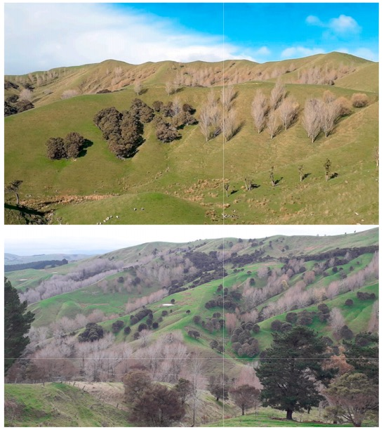
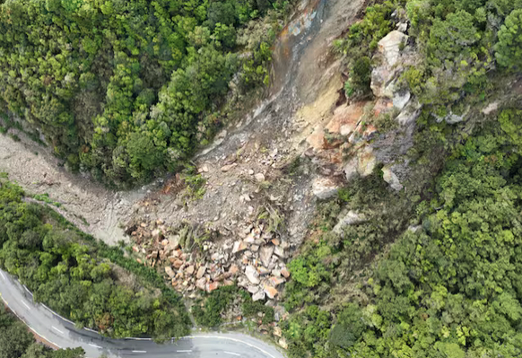
Background
Research Significance
Prevent Landslide happened in the Wairarapa area
Where exactly should we plant new trees?
Which types of trees work best?
Landslide
Wairarapa Landscape

Slide 3
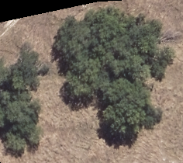
Background
What is Instance Segmentation of Individual Tree Crowns?
Goals:
Classification: Assign a class label to each canopy in the image
Detection: Provide the location of canopies in the form of bounding boxes
Segmentation: Provide the shape of canopies inside each detected bounding box
Willow/poplar1
Willow/poplar1
Willow/poplar
Willow/poplar3
Willow/poplar3
Willow/poplar2
Willow/poplar2
(a) Image classification
(b) Object detection
(c) Instance segmentation

Slide 4
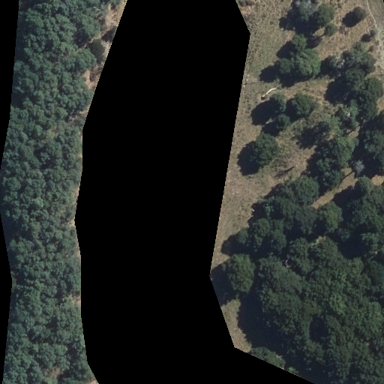
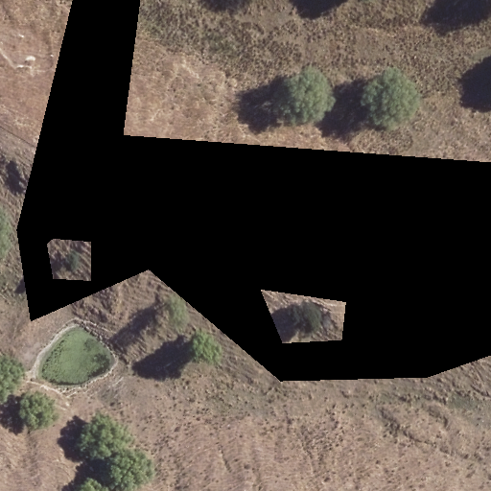
Background
Challenges
Shady
Dense stands result in overlapping and shady canopies.
Tree crown characteristics are complex, with variations in size, color, shape, and texture. Aerial imagery is difficult to provide sufficient information to distinguish variations in canopy characteristics, and there will be many small objects in the images.
The background or surroundings are likely to be identified as false positives, such as shrubs, weeds, and grass.
Uncertainties in data labelling
Small size
Overlapping
Tree-like grass

Slide 5
Background
Why YOLO?
Improved Accuracy and Speed
Efficient backbones and optimization algorithms
Advanced Multi-Scale Detection
Handle diverse object sizes
Robustness Against Varied Backgrounds
Enhanced feature extraction mechanisms and refined classification layers
Real-time Processing Capabilities
The streamlined architectures and efficient processing techniques
Feature maps
Head
Small object detection
80×80
Medium object detection
Image
Backbone
Neck
640×640
40×40
Large
object detection
20×20

Slide 6
Background
Thesis Outline
Chapter 1: Introduction
Problem Statement, Motivations, Research Goals, Major Contributions, Thesis Organization
Chapter 2: Literature Review
Image Segmentation, Mechine Learning, CNNs, CNNs for Instance Segmentation, Related Work
Chapter 3: YOLO-ITC
Dblock and Efficient Attention for Instance Segmentation of Individual Tree Crowns
Chapter 4: YOLOv8E
Efficient & Lightweight YOLOv8 with Enhanced Anchor-Free Sampling Selection Schemes
Chapter 5: YOLOv8-FF
Feature Fusion to improve YOLOv8 for Segmenting and Classifying Tree Crowns
Chapter 6: Conclusions and Future Work
Achieved Objectives, Conclusions, Future Work

Slide 7
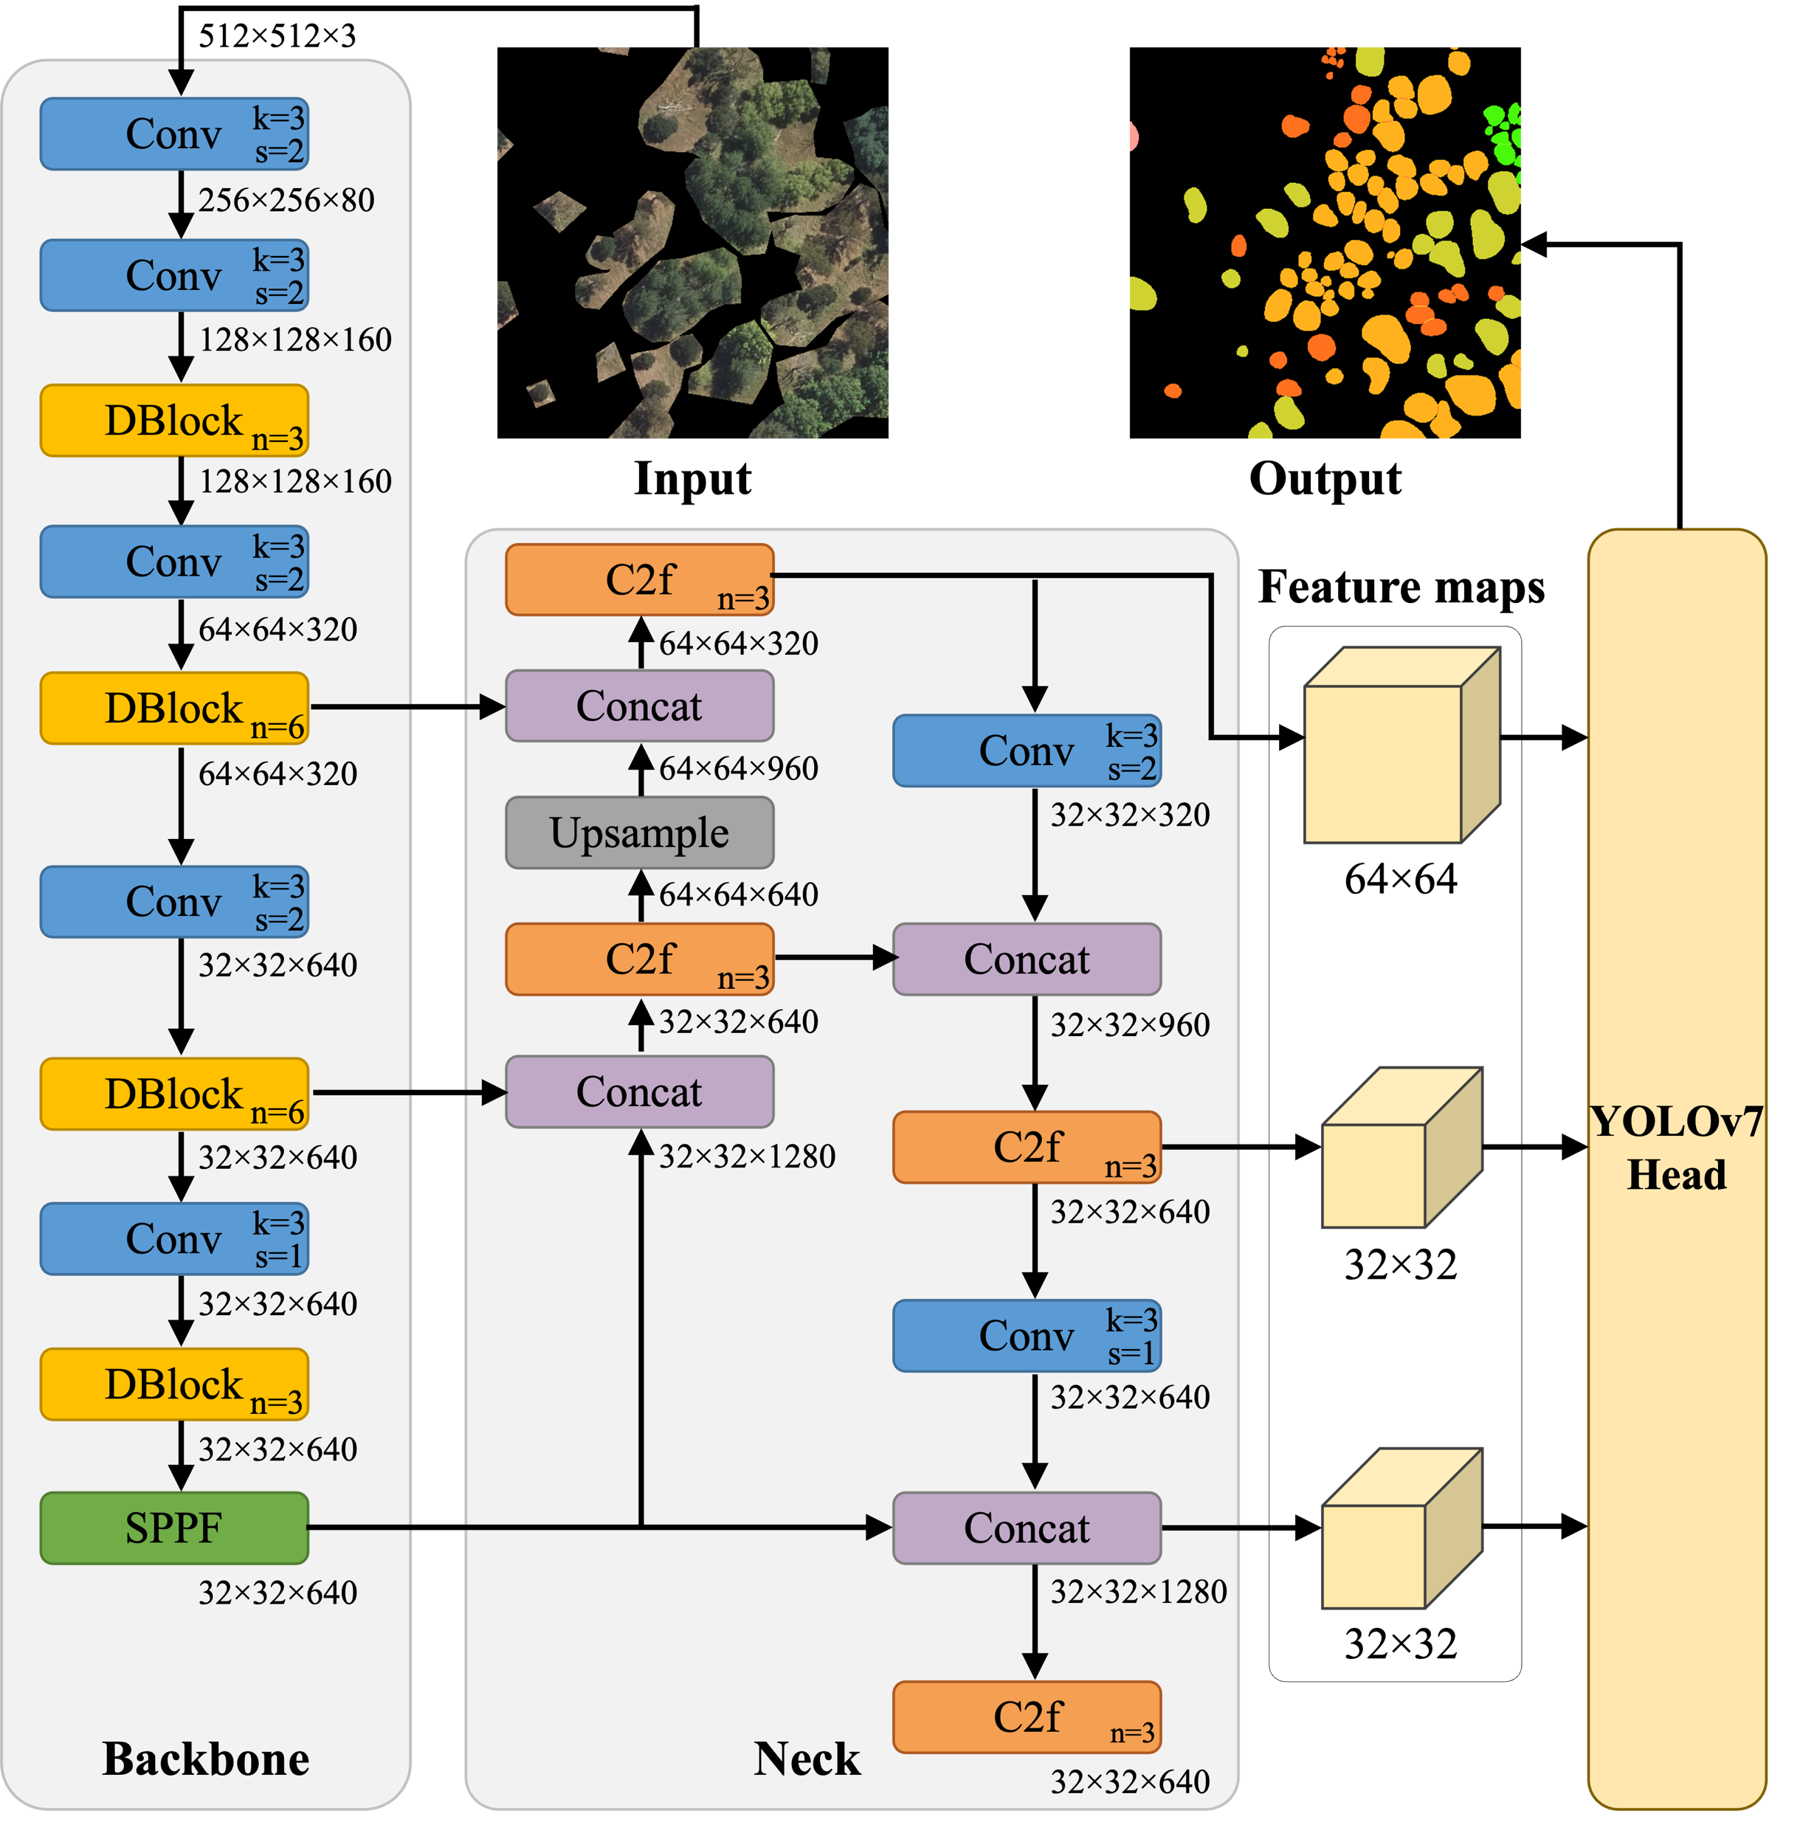
Chapter 3: YOLO-ITC with Dense Block and Efficient Attention
Overall Framework
The goal of YOLO-ITC is to effectively address the instance segmentation of individual tree crowns in aerial imagery
Demonstrate the strong effectiveness of YOLO-based architectures for the application of instance segmentation of individual tree crowns in Wellington
Enhance feature extraction in dense, complex canopy environments by using Dense Blocks and Efficient Attention
Reconfigure the large-object detection branch to focus on medium-scale canopies to enhance segmentation performance

Slide 8
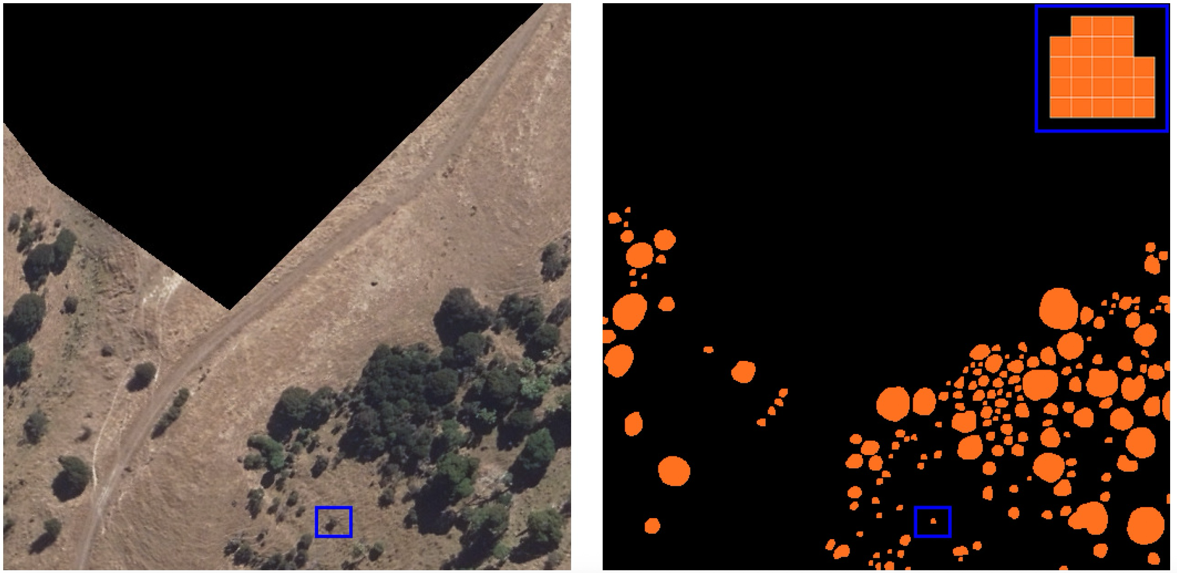
Chapter 4: YOLOv8E: Efficient and Lightweight Model
Methodology
The goal of YOLOv8E is to develop a more compact and accurate variant of the anchor-free YOLOv8 model.
Design two candidate positive sample selection schemes (A and B), by placing multiple keypoints within a grid cell, to raise the likelihood of capturing tiny canopies
Efficient network design by omitting the large object detection branch, saving computational resources
Adaptive hyperparameter tuning within the Task-Aligned Assigner
Two schemes for selecting candidate positive samples

Slide 9
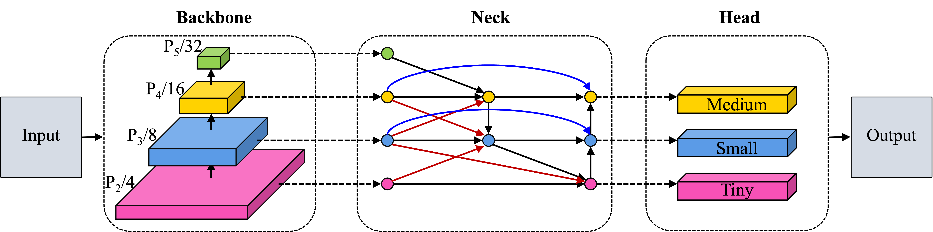
Chapter 5: YOLOv8-FF: Feature Fusion-Enhanced Model
Methodology
The goal of YOLOv8-FF is to propose a feature fusion-enhanced model based on YOLOv8 to address diverse canopy sizes
Design feature fusion techniques that incorporating same-scale and cross-scale fusion to preserve fine-grained details while capturing global context
Propose a refined network design for identifying tiny, small, and medium crowns
Incorporate large-kernel convolutions to expand the receptive field, improving the identification of medium-sized canopies
Same-scale fusion
Cross-scale fusion

Slide 10
Results
Quantitative Results
Method | Box AP | Mask AP | AP₅₀ | AP₇₅ | AP_{S} | AP_{M} | FLOPs | #Params
YOLO-ITC | 36.2 | 32.0 | 60.3 | 31.7 | 30.8 | 45.3 | 141.8G | 82.2M
YOLOv8E-A | 36.0 | 32.1 | 60.7 | 32.2 | 30.9 | 45.4 | 106.4G | 56.9M
YOLOv8E-B | 36.1 | 32.2 | 60.5 | 31.9 | 31.2 | 43.7 | 106.4G | 56.9M
YOLOv8-FF | 37.6 | 32.9 | 61.4 | 32.8 | 31.9 | 44.6 | 196.1G | 54.4M

Slide 11
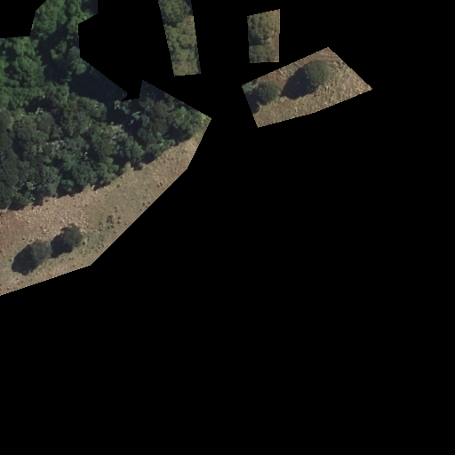
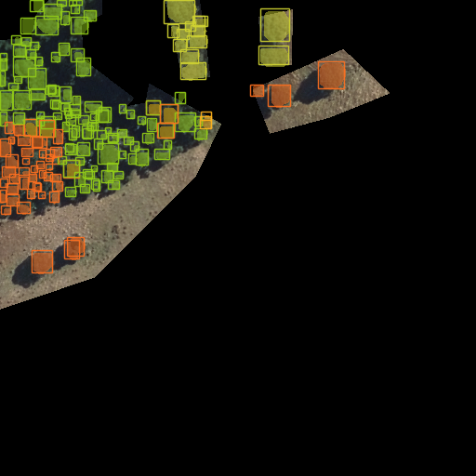
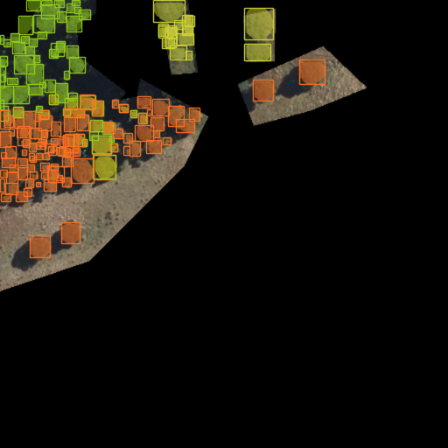


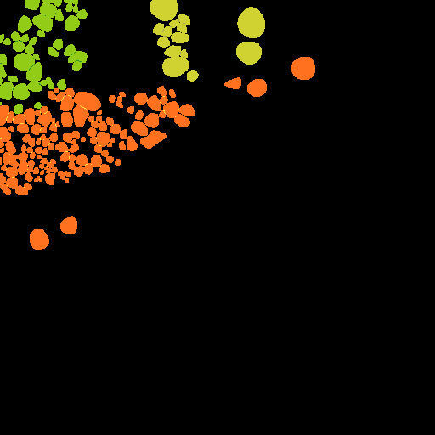
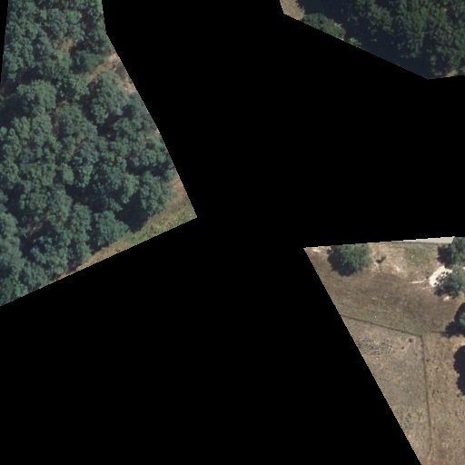
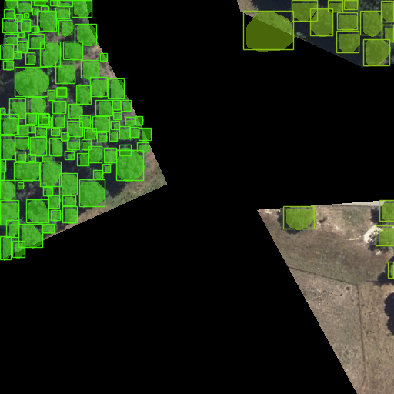
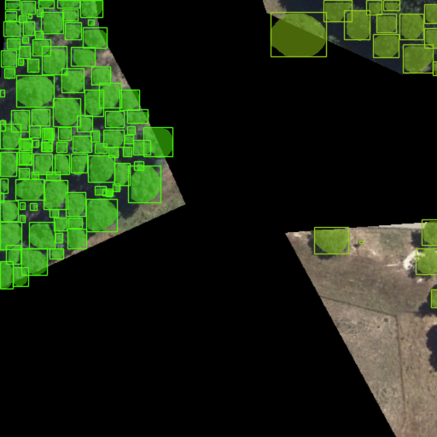
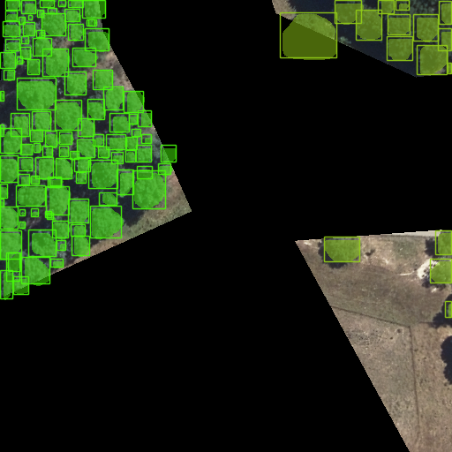


Results
Visual Results
Input
YOLOv8
YOLO-ITC
YOLOv8E-A
YOLOv8-FF
Ground-Truth

Slide 12
Contributions
This thesis develops innovative YOLO models to perform instance segmentation and species classification of individual tree crowns from aerial imagery by enhancing the feature extraction network, refining the detection framework, and developing efficient network architectures.
Develop YOLO-ITC with a new detection scheme, dense blocks with efficient attention to enhance the effectiveness of YOLO-based architecture.
Propose YOLOv8E with two novel sample selection strategies to better handle small canopies and the redesigned network to improve accuracy while reducing the model size and parameter count.
Propose YOLOv8-FF, a feature fusion-enhanced model that integrates cross-scale and same-scale fusion, alongside a sparse large kernel network for better global context aggregation.

Slide 13
Future Work
Overlapping and Ambiguously Bounded Tree Crowns
Model Generalization
Multi-Sensor and Multi-Spectral Data
Transformer-Based Architectures
Semi-Supervised and Active Learning Approaches
Real-Time and On-Device Implementation
Neural Architecture Search

Slide 14
Publications
[1] Ziyi Sun, Bing Xue, Mengjie Zhang, and Jan Schindler. “Feature Fusion to Improve YOLOv8 for Segmenting and Classifying Aerial Images of Tree Crowns.” IEEE Journal of Selected Topics in Applied Earth Observations and Remote Sensing (2025): 1-14.
[2] Ziyi Sun, Bing Xue, Mengjie Zhang, and Jan Schindler. “YOLO-ITC: A New YOLO Method for Instance Segmentation of Individual Tree Crowns.” IEEE Transactions on Emerging Topics in Computational Intelligence (2025): 1-15.
[3] Ziyi Sun, Bing Xue, Mengjie Zhang, and Jan Schindler. “YOLOv8E: an efficient YOLOv8 method for instance segmentation of individual tree crowns in Wellington City, New Zealand.” Journal of the Royal Society of New Zealand (2024): 1-26.
[4] Ziyi Sun, Bing Xue, Mengjie Zhang, and Jan Schindler. “An Improved Mask R-CNN for Instance Segmentation of Tree Crowns in Aerial Imagery.” 2023 38th International Conference on Image and Vision Computing New Zealand (IVCNZ), Palmerston North, New Zealand, 29-30th November 2023. pp. 1-6.

Slide 15
Thank you !

